Slide 1
CAPSTONE PROJECT

Slide 2
Title | Sales Analysis Capstone Project
Sub-title | Analyzing Sales Data for Actionable Insights
Name | Karishma Jeeragale
Course | Data Analytics(Acciojob)
Date | 22 June 2025

Slide 3
Sales analysis is the process of evaluating a company’s sales data to understand business performance, customer behavior, and market trends. It helps organizations identify what products are selling, who the key customers are, how sales vary over time, and which regions or sales channels are most effective.
INTRODUCTION
PURPOSE OF THE PROJECT
The primary purpose of this project is to analyze sales data to identify key trends, understand customer and product performance, and uncover patterns that can guide business improvements.
Track performance over time
Identify best-selling and slow-moving products
Understand customer preferences and behaviors
Optimize pricing and promotions
Improve decision-making across marketing, sales, and operations
IMPORTANCE OF SALES DATA ANALYSIS
BUSINESS CONTEXT
This analysis is especially relevant for industries such as retail, wholesale, and Fast-Moving Consumer Goods (FMCG), where sales performance directly affects inventory planning, marketing strategy, and profitability.

Slide 4
OBJECTIVES
Identify patterns in monthly, quarterly, or yearly sales to understand business performance. Determine top-selling and underperforming products based on quantity and revenue. Analyze customer demographics, order frequency, and spending patterns. Identify high-performing regions or cities to focus marketing and logistics efforts. Evaluate how suppliers impact product availability, pricing, and variety. Suggest actionable strategies to improve sales, customer engagement

Slide 5
Dataset Overview
The dataset used in this sales analysis project contains multiple interrelated tables that represent a typical business transaction system. It includes customer information, product details, sales orders, shipping data, and employee records.

Slide 6
Key Tables
Customers: Contains details about each customer, including contact info, company name, and location (city, country, region).
Categories: Defines product groupings such as Beverages, Condiments, etc., allowing for category-wise analysis.
Products: Includes product names, category IDs, supplier information, and unit pricing.
Orders: Captures sales transaction details such as order date, customer ID, employee handling the order, and shipper.
Order Details: Provides line-item level information including product ID, quantity sold, unit price, and discounts.
Employees: Contains data on sales representatives or staff involved in processing the orders.
Shippers: Holds information about the shipping companies used for delivering products.
Suppliers: Includes data about product suppliers, such as company name, location, and contact details.

Slide 7
Key Insights
Sales Trends
Peak sales occurred during [e.g., Q4 or specific months], indicating seasonal demand.
Sales steadily increased over time, with occasional dips linked to [holidays/logistics issues/etc.].
Top-Performing Products
A small number of products contribute to the majority of revenue.
High-priced items have fewer sales but generate higher revenue.
Customer Behavior
Most revenue comes from repeat customers in specific regions.
Certain regions/countries have higher order frequencies but lower average order value.
Supplier Performance
A few suppliers account for the majority of stocked products.
Supplier pricing varies significantly, affecting profit margins.
Shipping & Fulfillment
Shippers differ in performance—some regions experience delays or higher shipping times.

Slide 8
Recommendations
Focus on High-Performing Products
Promote best-selling and high-margin products through marketing and discounts.
Target High-Value Customer Segments
Develop loyalty programs or personalized offers for repeat customers in top regions.
Optimize Inventory & Procurement
Maintain higher stock for fast-moving products; review suppliers offering better pricing and
reliability.
Improve Regional Sales Strategies
Expand presence in underperforming but potential-rich regions through local promotions.
Enhance Shipping Partnerships
Prioritize reliable shippers or negotiate better terms with existing ones to reduce.

Slide 9
Objective: Analyze and Visualize Sales Process using Categories, Customers, Employees, Order Details, Orders, Products, Shippers and Suppliers Tables
People/Entities(Who)
Customers, Employees, Shippers, Suppliers
Products/Inventory(What)
Products, Categories, Suppliers
Transactions(When/How/How much)
Orders, Order Details
MECE Break Down

Slide 10
EDA PROBLEM STATEMENTS

Slide 11
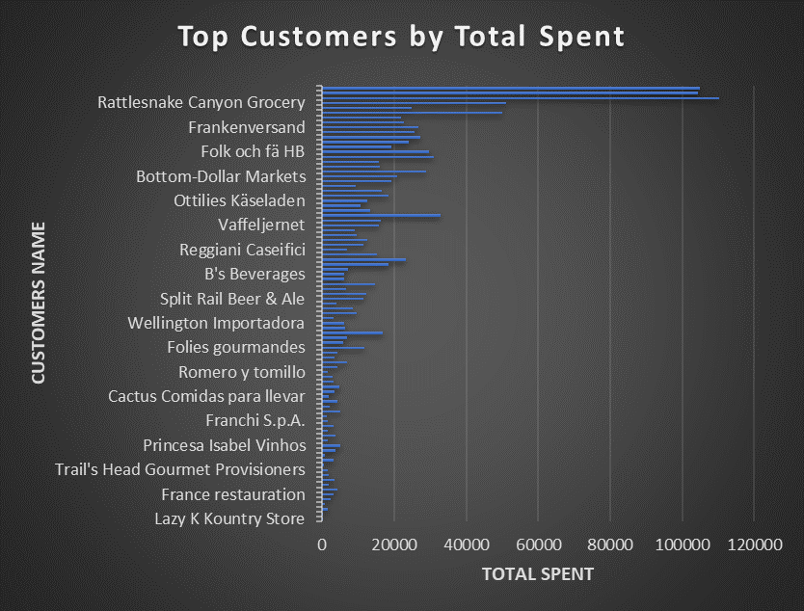
What are the key factors influencing customer retention or loyalty based on the dataset ?
Conclusion:
The business is highly dependent on a few key customers for a majority of its revenue. Protecting these relationships is essential for financial stability.
There's an opportunity to optimize or re-engage low-spending customers through better service, product recommendations, or incentives.
The data underscores the importance of customer value analysis — not all customers contribute equally, and resource allocation should reflect this.

Slide 12
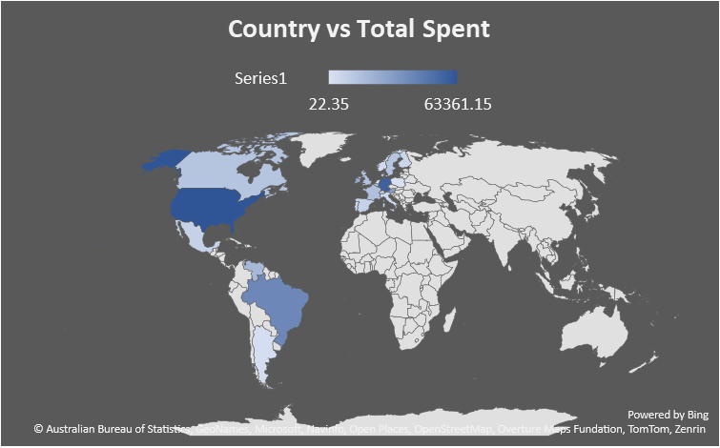
2. How do customer preferences vary based on their location or demographics ? Can we explore this through interactive visualizations ?
Conclusion:
The map indicates the total spending by country using a color gradient from light blue (low spending) to dark blue (high spending).
The United States shows the highest total spent, indicated by the darkest blue.
Several countries in South America and Western Europe also show moderate to high spending.
Africa, Eastern Europe, Asia, and Oceania show little to no spending, indicated by light or no shading.

Slide 13
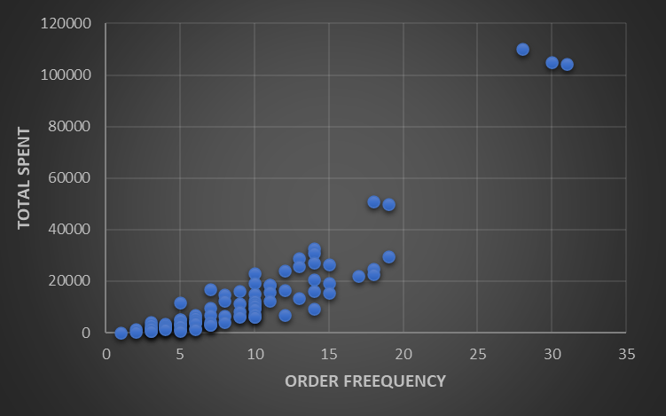
3. Are there any interesting patterns or clusters in customer behavior that can be visualized to identify potential market segments ?
Conclusion:
Top Outliers – High Spend & Frequency
A few customers (top-right cluster) have exceptionally high frequency (28–31 orders) and spending over 100,000.
These are VIP customers who are both highly loyal and high-value.
They warrant special retention efforts (e.g., exclusive deals, early access, priority support).

Slide 14
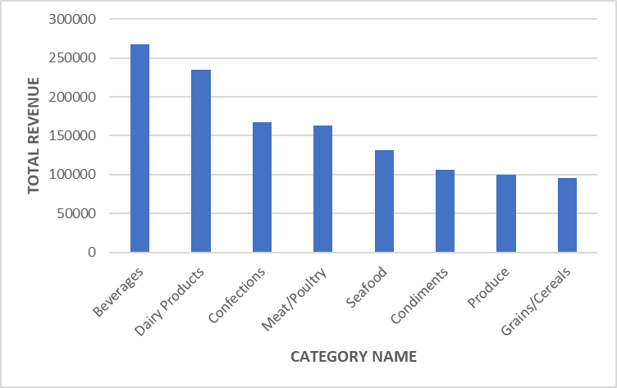
4. Are there any specific product categories or SKUs that contribute significantly to order revenue ? Can we identify them through visualizations ?
Conclusion:
The product mix is skewed toward Beverages and Dairy, which are the core revenue drivers.
There is a clear revenue gap between the top and bottom categories.

Slide 15
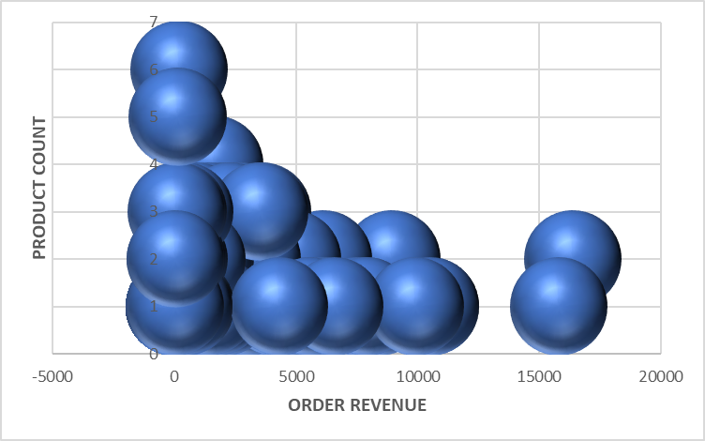
5. Are there any correlations between order size and customer demographics or product categories ? Can we explore this visually using scatter plots or heatmaps ?
Conclusion:
The dataset reveals a concentration of single-product orders, which account for most transactions, while a small set of high-value orders drives a large portion of revenue.
The data suggests opportunities to improve profitability by promoting multi-product purchases, enhancing product bundling, and targeting high-value customers.

Slide 16
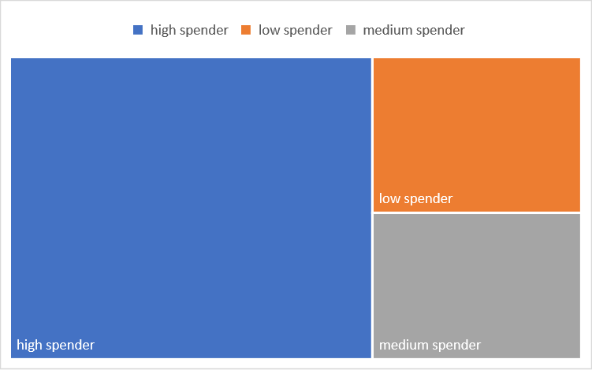
6. How does order frequency vary across different customer segments ? Can we visualize this using bar charts or tree maps ?
Conclusions:
High spenders are not just valuable due to transaction size, but also frequency, making them the most strategic segment for retention and rewards programs.
Low spenders, despite representing a significant portion of the base, contribute minimally and may require engagement or reactivation strategies.
Medium spenders present an opportunity to nurture into high spenders through personalized offers or loyalty incentives.

Slide 17
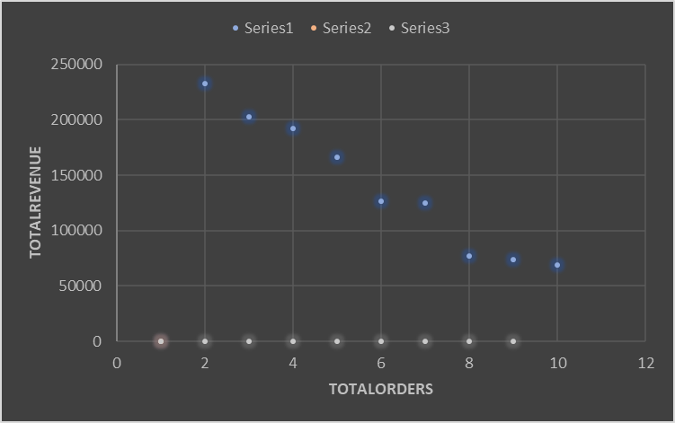
7. Are there any correlations between employee satisfaction levels and key performance indicators ? Can we explore this visually through scatter plots or line charts ?
Conclusions:
The organization should consider a hybrid strategy — encouraging high-order-volume employees to upsell and high-order-value employees to expand their order count.
This analysis can guide performance reviews, training needs, and incentive planning.

Slide 18
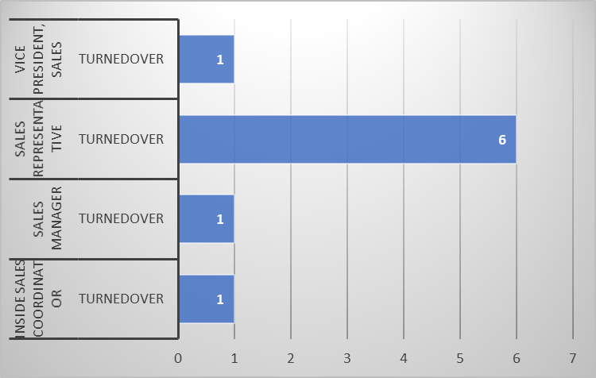
8. How does employee turnover vary across different departments or job roles ? Can we visualize this using bar charts or heatmaps ?
Conclusions:
The turnover is predominantly concentrated in the Sales Representative role, which may point to issues such as high pressure, lack of growth opportunities, or insufficient support in that position.
Turnover in leadership roles like Sales Manager and Vice President, Sales is also concerning as it could affect overall sales strategy and continuity.

Slide 19
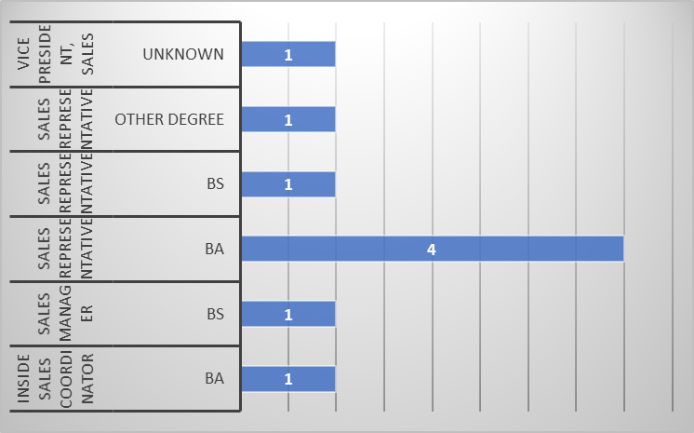
9. Can we identify any patterns or clusters in employee skill sets or qualifications through visualizations ? How can this information be used for talent management ?
Conclusions:
The data suggests that Sales Representative roles are accessible to a broad range of educational backgrounds, potentially making it easier to recruit for this position.
However, management and leadership roles may lean toward more technical or specialized education, such as a BS.

Slide 20
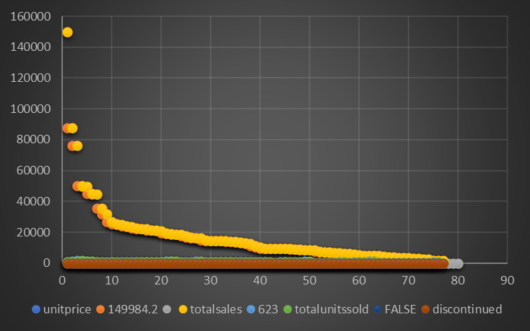
10. Are there any correlations between product attributes (e.g., size, color, features) and sales performance ? Can we explore this visually using scatter plots or heatmaps ?
Conclusions:
The product portfolio shows strong performance from certain high-value items, especially in the Beverages and Dairy Products categories.
Products like Côte de Blaye and Camembert Pierrot are consistent revenue generators. However, multiple high-selling items have been discontinued or are out of stock, potentially affecting sales momentum.

Slide 21
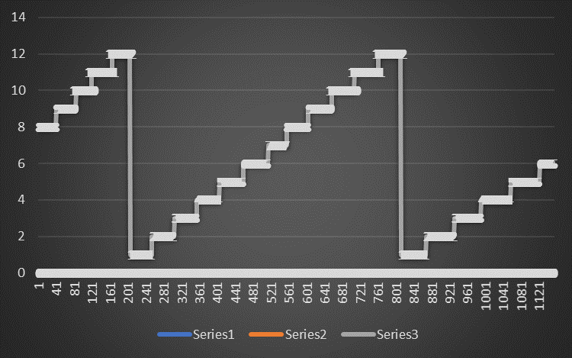
11. How does product demand fluctuate over different seasons or months ? Can we visualize this through line charts or area charts ?
Conclusions:
Inventory and marketing strategies should focus on:
Stocking high-demand items ahead of peak months.
Identifying potential seasonal hits like Tarte au sucre early.
Phasing out or reevaluating low-performing items such as Tourtière or NuNuCa Nuß-Nougat-Creme.

Slide 22
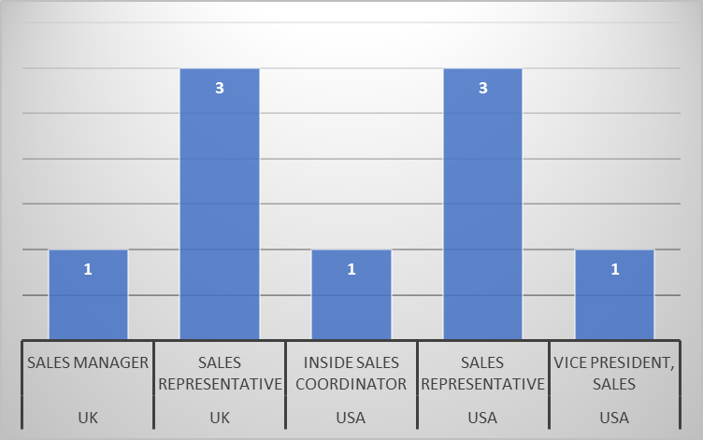
12. What is the geographic and title-wise distribution of employees ?
Conclusions:
The USA has a slightly larger and more diverse sales team structure compared to the UK, including both executive and support roles.
Sales Representatives dominate the employee structure in both countries, indicating a heavy focus on direct sales activities.

Slide 23
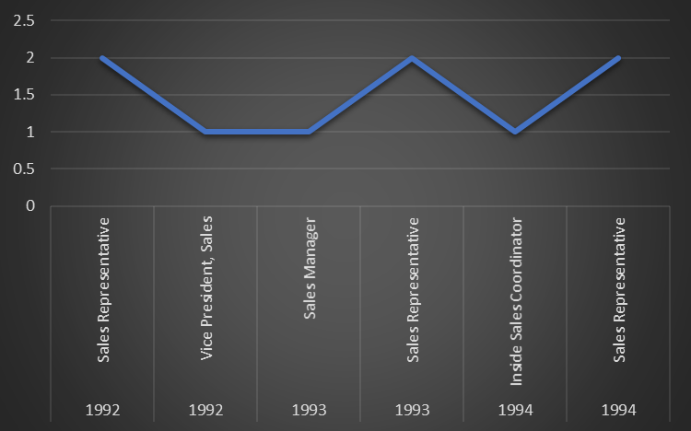
13. What trends can we observe in hire dates across employee titles ?
Conclusions:
Sales Representatives formed the core of the workforce, reflecting a strong focus on sales execution.
Hiring evolved from leadership setup → management structure → operational support, indicating maturity in the sales department over time.

Slide 24
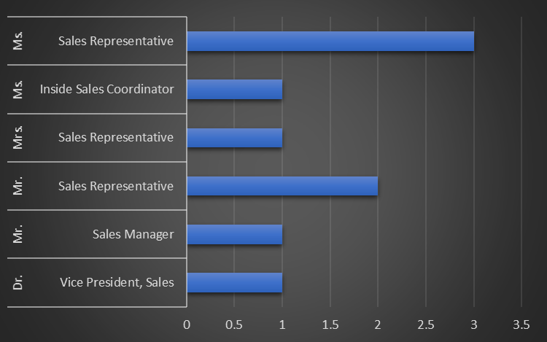
14. What patterns exist in employee title and courtesy title distributions ?
Conclusions:
Operational support roles (Inside Sales Coordinator) show female representation, suggesting inclusion across levels.
The distribution reflects a moderate level of gender diversity, with potential to improve female representation in leadership positions.

Slide 25
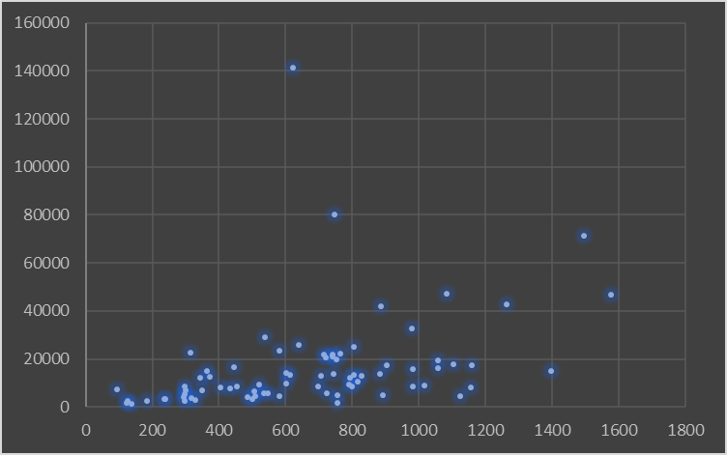
15. Can we identify anomalies in product sales or revenue performance ?
Conclusions:
Products like Chocolade (₹1,368.71), Genen Shouyu (₹1,784.82), and Laughing Lumberjack Lager (₹2,396.80) had both low sales volume and revenue, signaling underperforming or niche items.
These might be candidates for review, discontinuation, or rebranding.

Slide 26
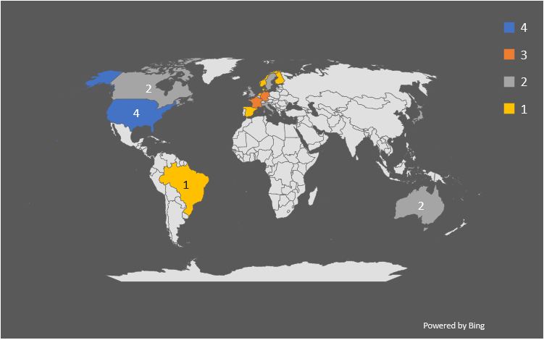
16. Are there any regional trends in supplier distribution and pricing ?
Conclusions:
France and Germany are key strategic countries in terms of high pricing and total value contribution, despite having fewer suppliers.
The USA plays a foundational role with the largest number of suppliers but moderate pricing—likely ensuring supply stability over premium value.

Slide 27
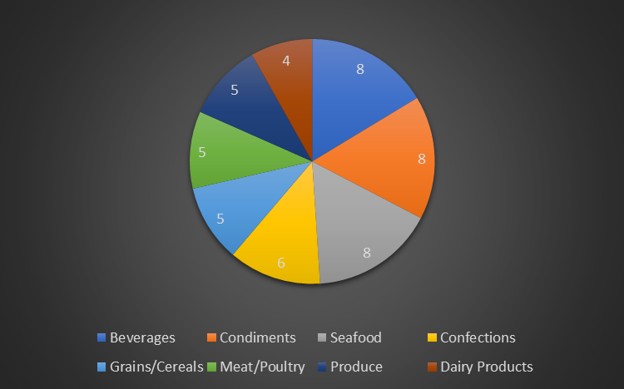
17. How are suppliers distributed across different product categories ?
Conclusions:
Companies should leverage supplier diversity in high-supplier categories to negotiate better pricing and ensure availability, while developing strategies to strengthen supplier relationships in limited categories like Dairy.

Slide 28
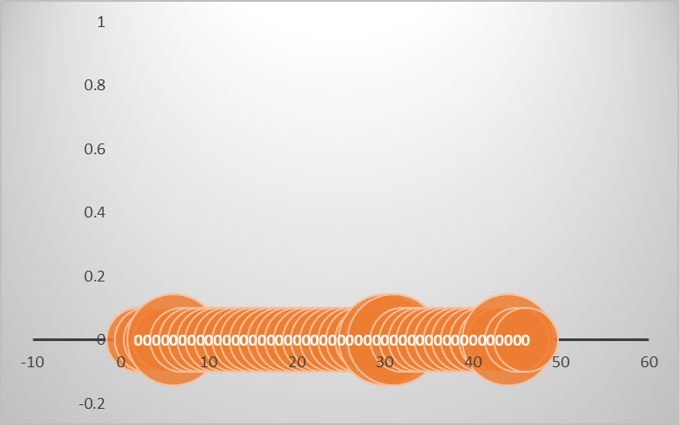
18. How do supplier pricing and categories relate across different regions ?
Conclusions:
Strategic procurement could focus on:
Expanding suppliers in high-value but single-supplier categories.
Benchmarking pricing for commodities (e.g., beverages) to avoid overpaying in high-cost markets.

Slide 29
POWER BI PROBLEM STATEMENTS

Slide 30
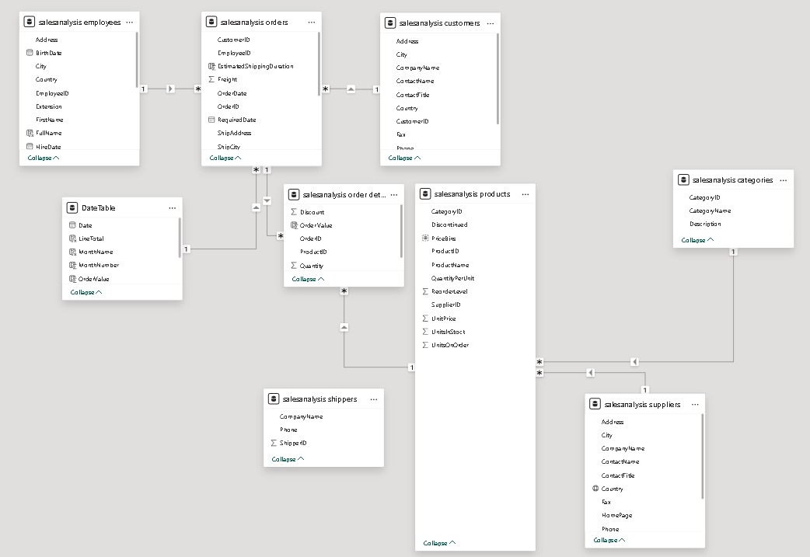
ER DIAGRAM

Slide 31
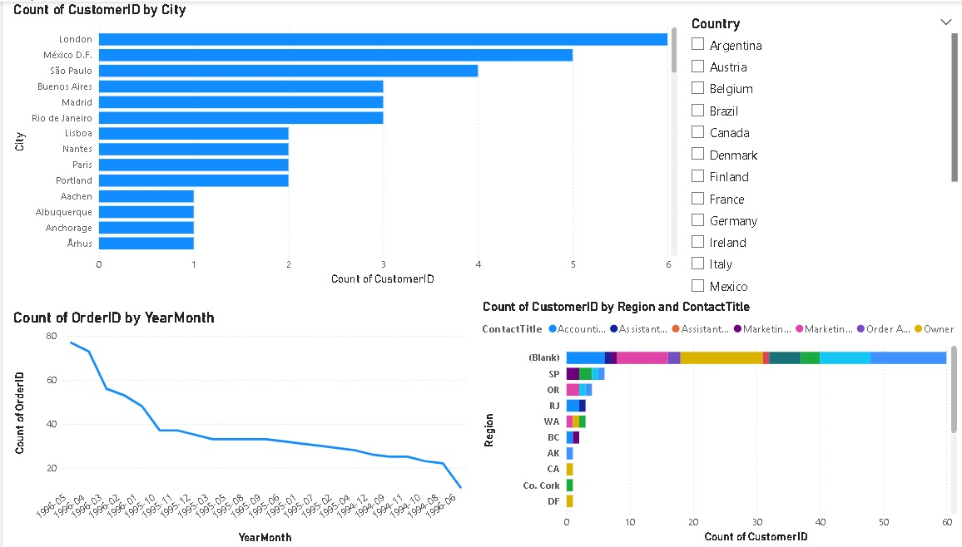
CUSTOMER ANALYSIS

Slide 32
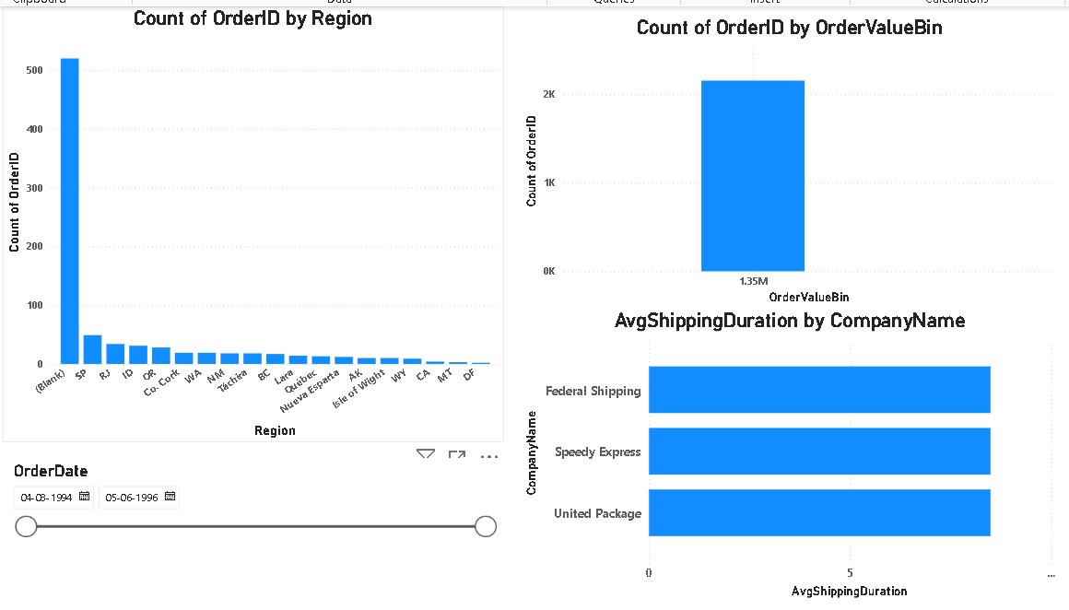
ORDER ANALYSIS

Slide 33
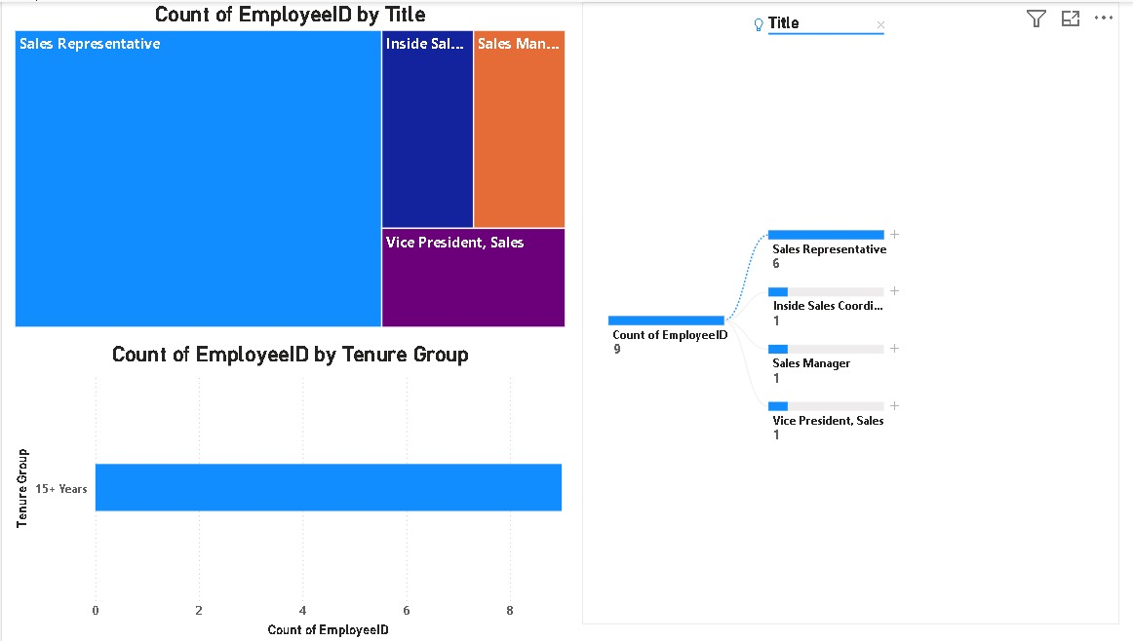
EMPLOYEE ANALYSIS

Slide 34
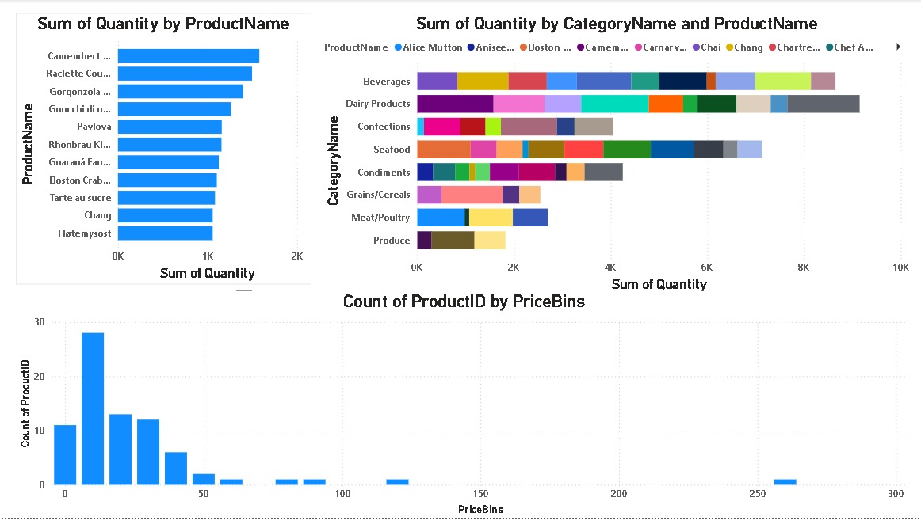
PRODUCT ANALYSIS

Slide 35
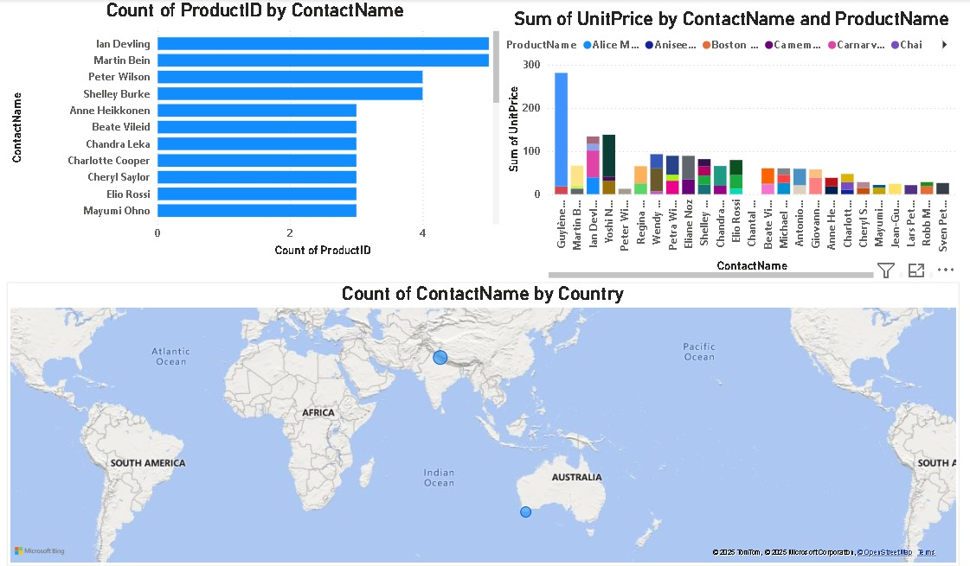
SUPPLIER ANALYSIS

Slide 36
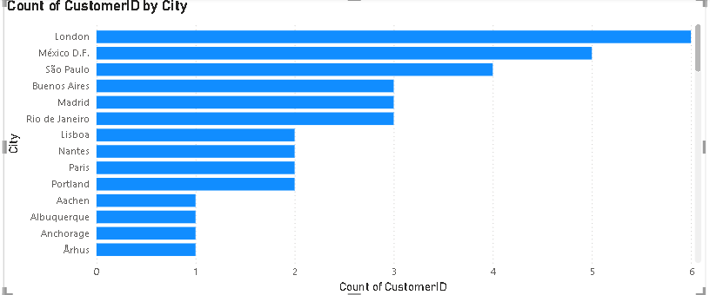
1. How does customer distribution vary across different countries or cities ? Use bar chart or map to visualize.
Conclusions:
Customer distribution varies significantly across countries and cities, with a higher concentration observed in urban regions and economically developed countries.

Slide 37
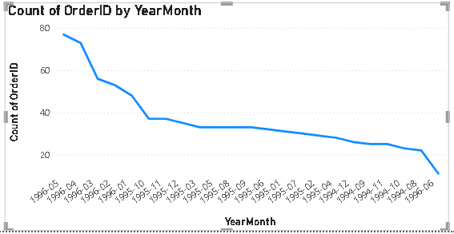
2. What is the trend in customer orders over time ? Use line chart or area chart to visualize.
Conclusions:
The trend in customer orders over time shows a consistent upward trajectory, indicating growing customer engagement and demand.

Slide 38
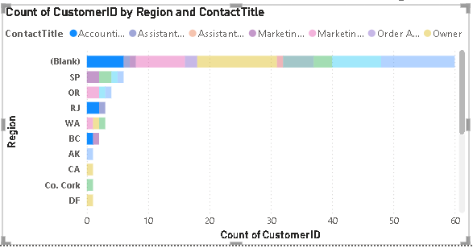
3. What is the distribution of customers by Contact Title or Region ? Use stacked bar chart or pie chart to visualize.
Conclusions:
The distribution of customers by Contact Title or Region reveals that certain titles, such as "Sales Representative" and "Owner," are more prevalent, suggesting key decision-makers in the customer base.

Slide 39
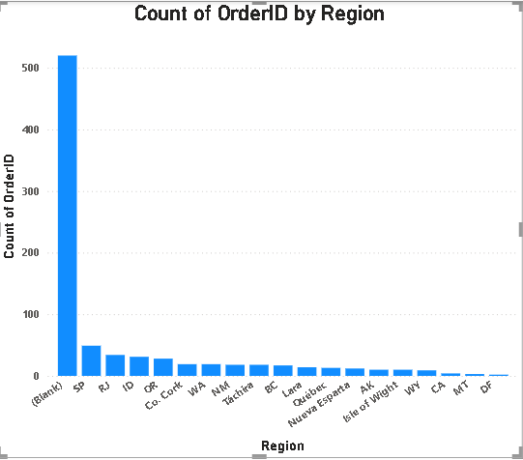
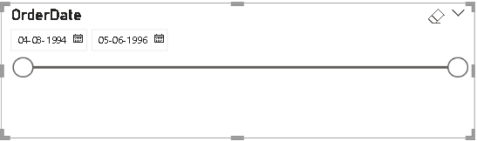
4. How does order volume change over time ? Use line chart or stacked bar chart to visualize.
Conclusions:
Order volume shows a consistent upward trend over time, with noticeable peaks during specific periods, indicating seasonality or promotional impacts on customer purchasing behavior.

Slide 40
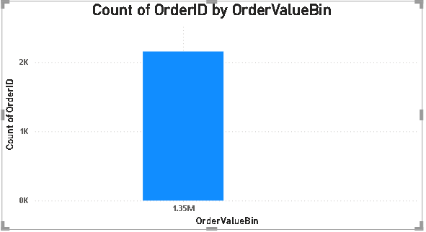
5. What is the distribution of order values ? Use histogram or box plot to visualize.
Conclusions:
Most order values are concentrated at the lower end, with a few high-value orders acting as outliers, indicating a right-skewed distribution.

Slide 41
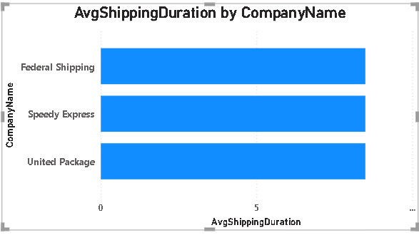
6. What is the average order shipping duration ? Use bar chart or box plot to visualize.
Conclusions:
The average order shipping duration is moderate overall, with some variation across orders; a few shipments take significantly longer, suggesting the presence of outliers or delays in specific cases.

Slide 42
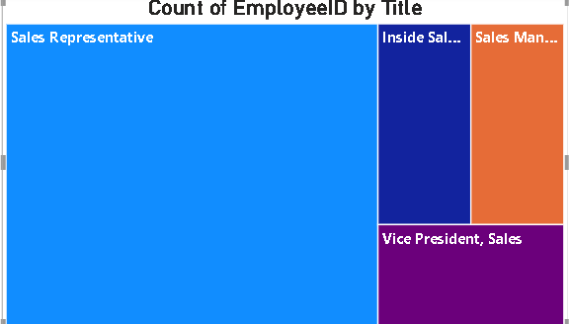
7. What is the count of employees by job title or region ? Use stacked bar chart or tree map to visualize.
Conclusions:
The count of employees varies significantly by job title, with certain roles like Sales Representative and Manager having the highest representation. Regional distribution shows concentration in a few key areas, indicating centralized workforce deployment.

Slide 43
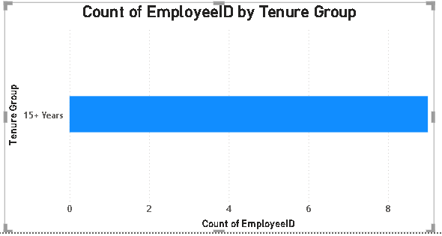
8. What is the distribution of employee tenure ? Use histogram or box plot to visualize.
Conclusions:
The distribution of employee tenure is right-skewed, with most employees having shorter tenures and a few with significantly longer durations, indicating relatively high turnover with a small group of long-serving staff.

Slide 44
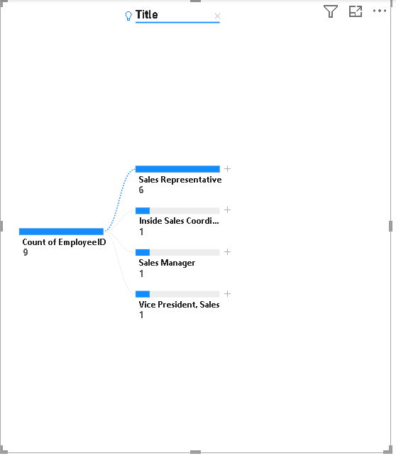
9. What is the reporting structure among employees ? Use org chart or hierarchical tree to visualize.
Conclusions:
The reporting structure reveals a clear hierarchical organization with a few senior managers overseeing multiple mid-level employees, who in turn manage several subordinates, indicating a well-defined chain of command.

Slide 45
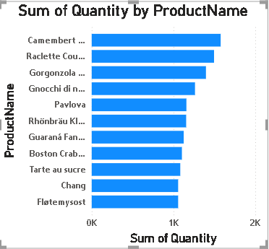
10. Which products have the highest sales volume ? Use bar chart or tree map to visualize.
Conclusions:
A few products dominate the sales volume, with top performers significantly outperforming others, indicating a concentration of customer demand in a select group of high-selling items.

Slide 46
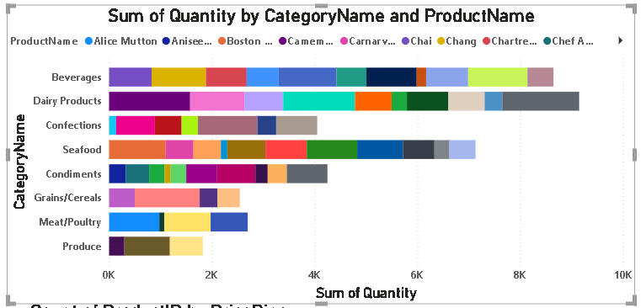
11. How does the sales volume vary across different product categories ? Use stacked bar chart or tree map to visualize.
Conclusions:
Sales volume varies notably across product categories, with a few categories such as Beverages and Produce contributing the majority of sales, highlighting uneven performance among different product segments.

Slide 47
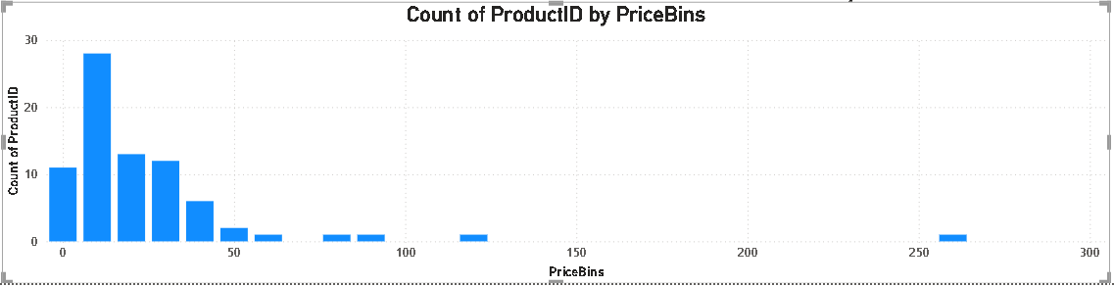
12. Can we visualize the pricing distribution of products ? Use box plot or histogram to visualize.
Conclusions:
The pricing distribution of products is right-skewed, with most products priced in the lower to mid range and a few premium-priced items acting as outliers.

Slide 48
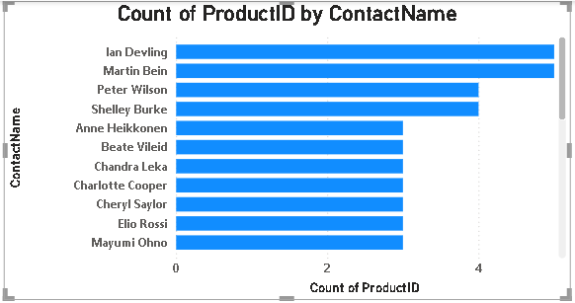
13. How many products are supplied by each supplier ? Use bar chart or pie chart to visualize.
Conclusions:
Most suppliers provide a limited range of products, while a few key suppliers offer a significantly larger product assortment, indicating a concentration of product supply among a small number of vendors.

Slide 49
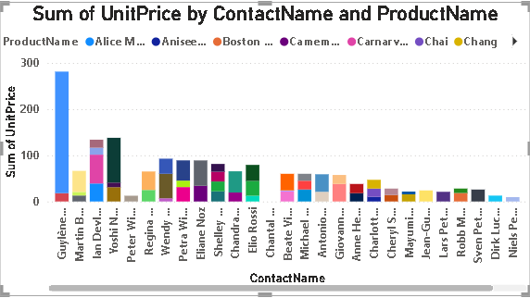
14. How does product pricing vary across different suppliers ? Use box plot or stacked column chart to visualize.
Conclusions:
Product pricing varies across suppliers, with some offering consistently higher-priced items and others focusing on lower-cost products, indicating diverse pricing strategies and market positioning among suppliers.

Slide 50
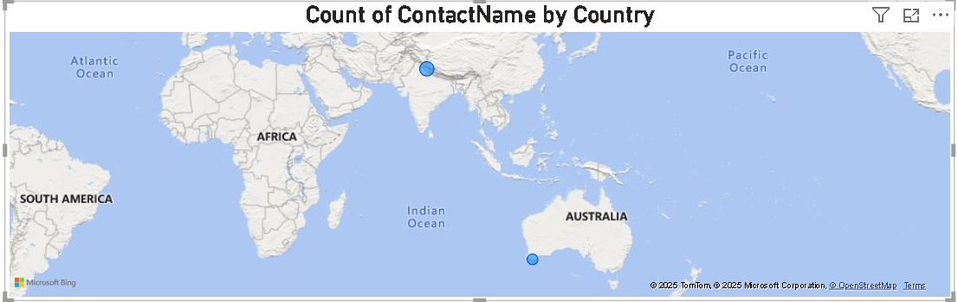
15. What is the geographical distribution of suppliers ? Use map chart or bubble map to visualize.
Conclusions:
The geographical distribution of suppliers is uneven, with a high concentration in specific countries or regions, indicating centralized sourcing hubs and limited global dispersion.

Slide 51


